Slide 1
J2EE Structure & Definitions
Catie Welsh
CSE 432
http://www.developer.com/java/ejb/article.php/1434371
http://java.sun.com/j2ee/1.4/docs/tutorial/doc/index.html

Slide 2
J2EE Breakdown
Web Clients – contain 2 parts
  Dynamic Web pages containing HTML, XML
  Web browser, which renders the pages received from the server.
Web Components – servlets or pages created using JSP technology
Business Components – EJBs
  Retrieves data from storage(database), processes it, and sends it back to the client program.

Slide 3
J2EE
Servlets, JSP pages, filters, and web event listeners typically execute in a web container and may respond to HTTP requests from web clients. Servlets, JSP pages, and filters may be used to generate HTML pages that are an application’s user interface. They may also be used to generate XML or other format data that is consumed by other application components. A special kind of servlet provides support for web services using the SOAP/HTTP protocol.
Servlets, pages created with the JavaServer Pages™ technology, web filters, and web event listeners are referred to collectively in this specification as “web components.” Web applications are composed of web components and other data such as HTML pages. Web components execute in a web container.
A web server includes a web container and other protocol support, security support, and so on, as required by J2EE specifications.
Enterprise JavaBeans™ (EJB) components execute in a managed environment that supports transactions. Enterprise beans typically contain the business logic for a J2EE application. Enterprise beans may directly provide web services using the SOAP/HTTP protocol.

Slide 4
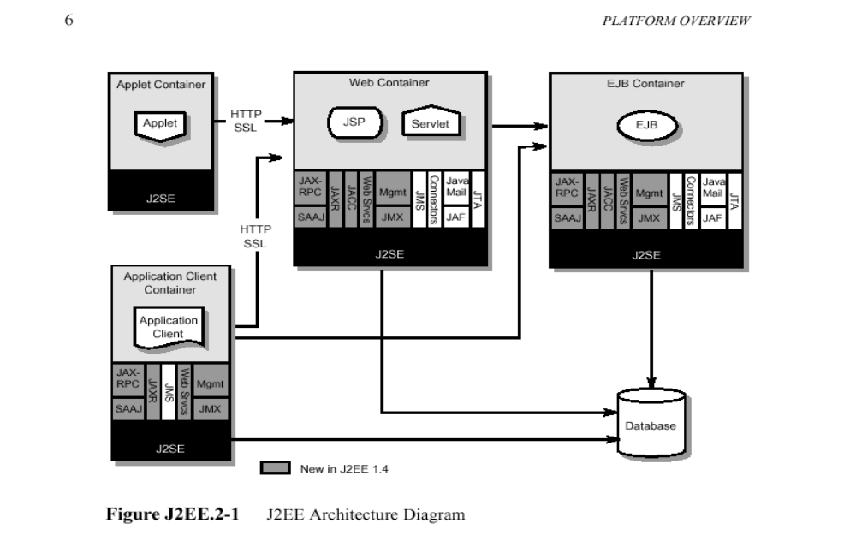
J2EE Structure Diagram

Slide 5
Types of J2EE Modules
EJB modules – contain the class files for enterprise beans and an EJB deployment descriptor. EJB modules are packaged as JAR files with a .jar extension.
Web modules – contains servlet class files, JSP files, supporting class files, GIF and HTML files and a Web application deployment descriptor. Web modules are packaged as JAR files with a .war (Web archive) extension.

Slide 6
JSP
JSP’s are executed server-side. Don’t get confused and think the code is executing client side in the browser.
There is a two step compilation process.
  Step 1- the commingled jsp/html code is translated to a Java Servlet
  Step 2 - it is compiled like any other Java class and (re)deployed in the application server

Slide 7
JSP Example Code
<jsp:useBean id='loginBean' scope='session‘ class='com.icanon.web.util.Login' type="com.icanon.web.util.Login"/>
<%
boolean loginOK = false;
String login_id = request.getParameter("login_id");
login_id = login_id.toLowerCase();
String password = request.getParameter("password");
loginOK = loginBean.loginCheck(login_id, password);
if(loginOK){
//do something
}
%>

Slide 8
Serializable Objects
RMI used for EJB's and JSP's/Java files to communicate with EJB's
EJB's can transfer complex objects over a network connection, object must be type that can be written as binary information (static data) Ex. ArrayList, String, HashMap
Ex. of Non-Serializable objects: Database connection, reference to other EJB's, graphical widgets (Calendar), ResultSet

Slide 9
EJBs
An EJB is essentially a managed component that is created, controlled, and destroyed by the J2EE container in which it lives.
When an EJB instance is no longer needed, it is returned to the pool and its resources are released. When it is needed, it is assigned to a client.
The client that uses the EJB instance does not need to know about all of this work by the container. As far as the client is concerned, it is talking to a remote component that supports defined business methods.

Slide 10
EJB Servers
The EJB server is the base set of services on top of which the container runs.
They are usually included in most J2EE-compliant application servers such as WebLogic and WebSphere.

Slide 11
3 Types of EJB’s
Session – A Session EJB is useful for mapping business process flow. There are two sub-types of Session EJB: stateless and stateful
Message – A Message-driven EJB is very similar in concept to a Session EJB, but is only activated when an asynchronous message arrives.
Entity – An Entity EJB maps a combination of data and associated functionality.

Slide 12
Session EJBs
A stateless session bean only contains a state for the duration of its invocation. Once the method is finished, the state is no longer maintained.
A stateful session bean, the instance variables represent the state of a unique client-bean session. The state is maintained for the duration of the session.

Slide 13
Entity EJBs
Entity beans differ from session beans in that they are:
  Persistent
  Allow shared access
  Have primary keys
  Participate in relationships with other entity beans
Entity beans represent a business entity but not a procedure.
  For example, CreditCardBean would be an entity bean, but CreditCardVerifierBean would be a session bean.

Slide 14
Message-driven EJBs
The most visible difference between message-driven beans and session and entity beans is that clients do not access message-driven beans through interfaces.
Message-driven beans have the following characteristics:
  They execute upon receipt of a single client message.
  They are invoked asynchronously.
  They are relatively short-lived.
  They do not represent directly shared data in the database, but they can access and update this data.
  They can be transaction-aware.
  They are stateless.

Slide 15
Common Uses of EJBs
In web-oriented applications, EJBs are used to supply the business logic behind the components, such as servlets and JSPs.
Thick-client applications, such as Swing apps, use EJBs similarly, to supply the business logic.
Business-to-business e-commerce applications use EJBs since they offer an ideal place to house the business process logic.

Slide 16
Common types of EJBs
A servlet or JSP that provides an HTML-based interface for a browser client
Another EJB that can delegate certain of its own tasks or can work in combination with other EJBs to achieve its own goals
A Java/Swing application that provides a front-end for the business processes encapsulated in the EJB
A CORBA application that takes advantage of the EJB's business logic
An applet that takes advantage of the business logic in a remote EJB so that this business logic does not need to be downloaded to the client

Slide 17
Advantages of EJBs
Hiding complexity – business developers want to write business code, without having to know how all the interactions work
Separation of Business Logic from UI and Data Access
Container Services – distribution via proxies, lifecycle management, name and registration, transaction management, security and access control, persistence

